Slide 1
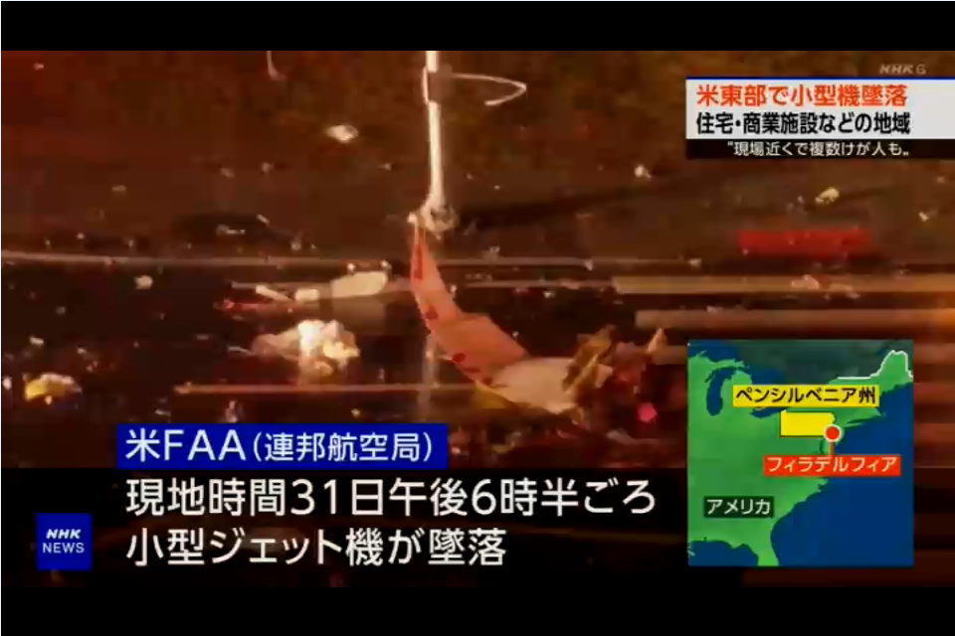
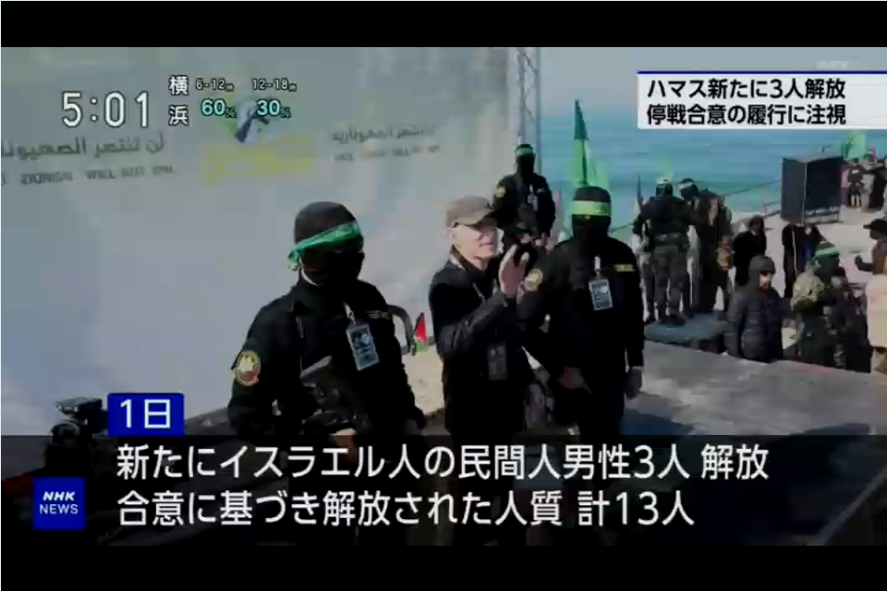
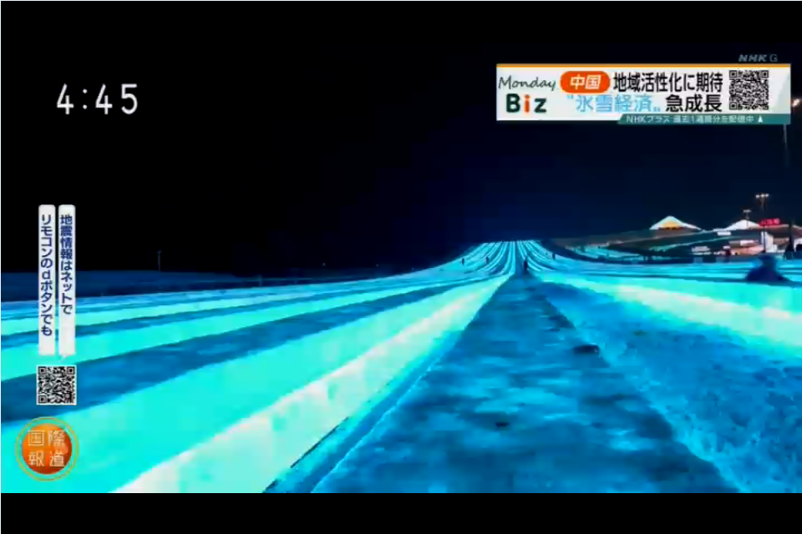
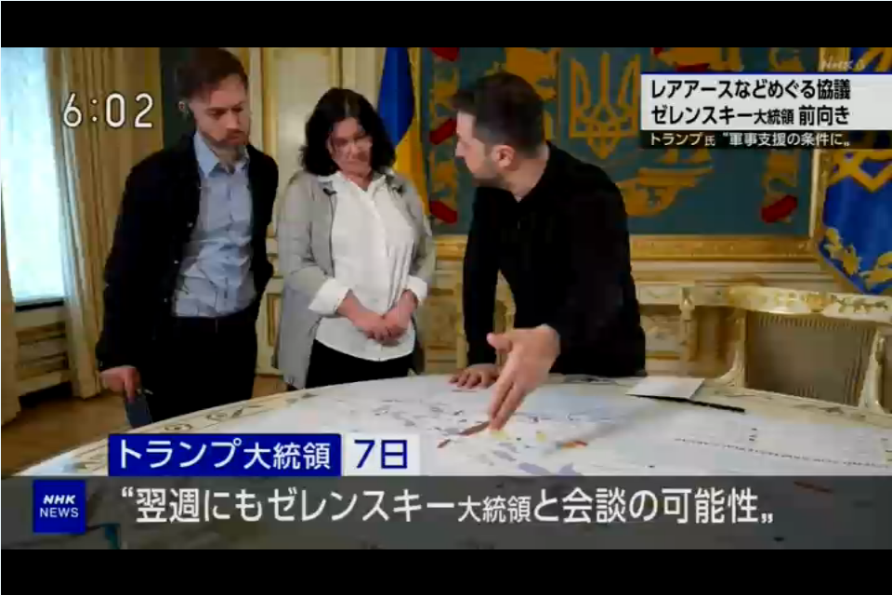
NHK remains one of Reuters’ oldest broadcast clients with a relationship dating back decades. Use of Reuters video has doubled in the last five years.
Wars in Gaza and the Ukraine accounted for 45% of Reuters usage in 2024, with the election maintaining demaind for US video. In 2024, NHK and NHK World used over 7,00 video assets from 137 countries.

Slide 2
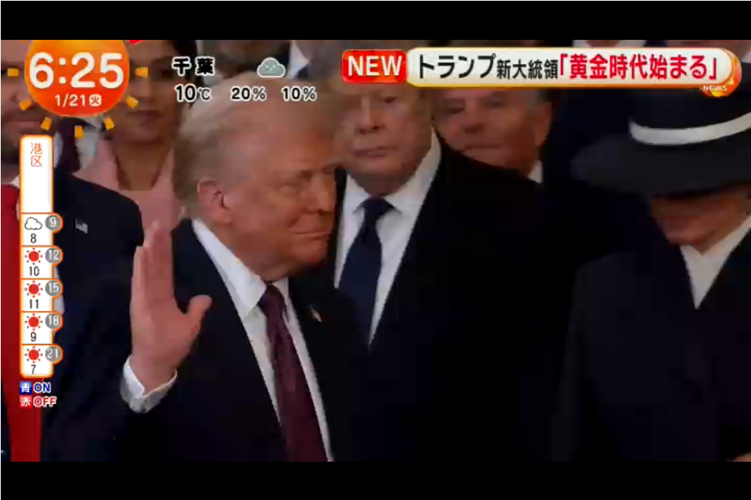
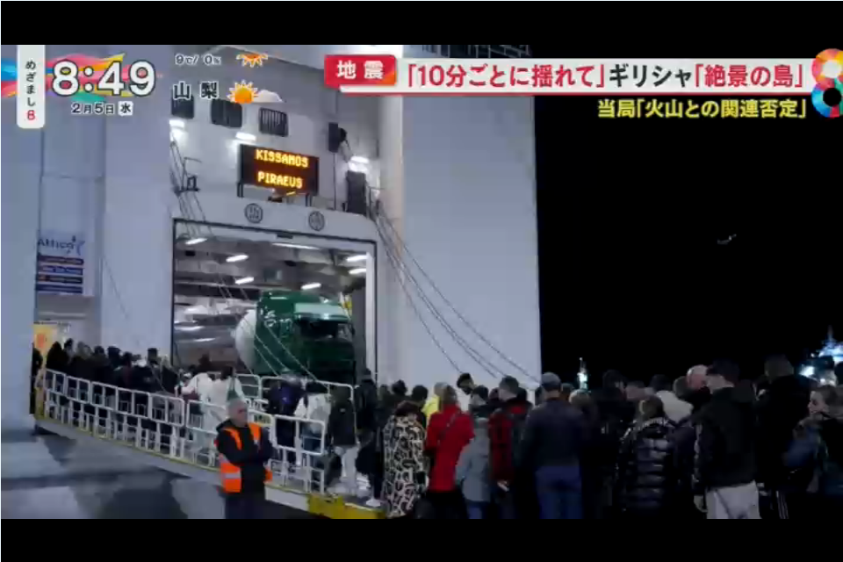
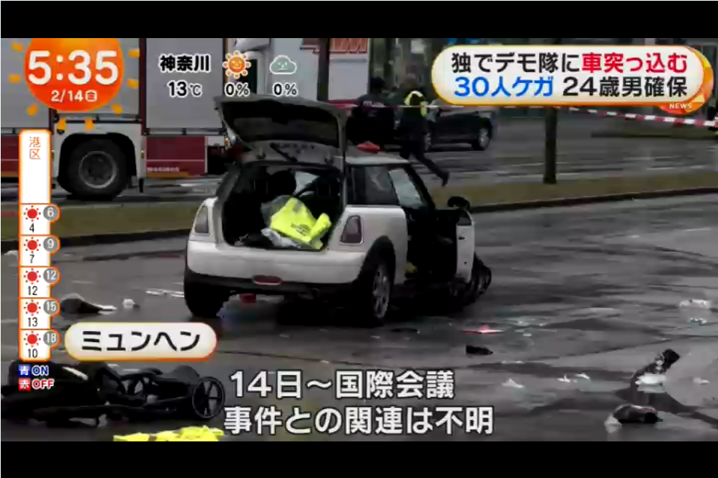
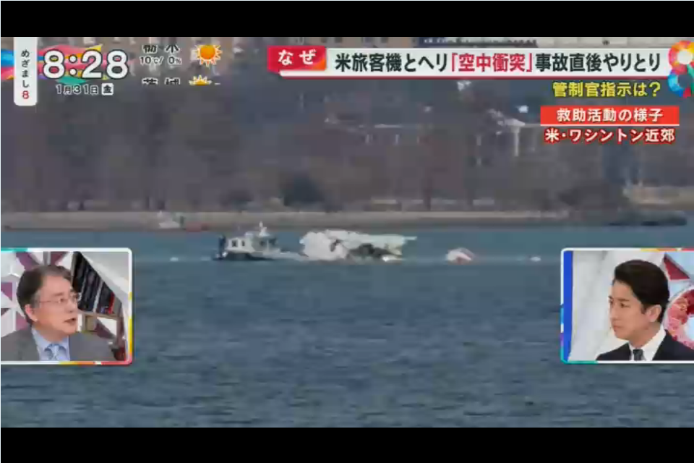
Fuji TV’s use of Reuters video progressed its gentle upwards trend in 2024, which has seen baseline usage double in the last five years.
It remains very reliant on Reuters video for coverage from the US and used nearly 4,000 video assets from 130 countries.
GAZA WAR: 14.8%
UKRAINE WAR: 9.6%
TRUMP/ELECTION: 16%
Of all detections of Reuters video on Fuji TV in 2024.

